Slide 1

Project Report
Hate Speech Detection
25-Nov-2021

Slide 2
Agenda
Problem Description
Business Understanding
Project Lifecycle
EDA
Models Performance Comparison
Recommendations
Deployment of the Best Model

Slide 3
Problem Description
The term hate speech is any form of expression (verbal, written, or behavioral communication) that attacks or uses derogatory or discriminatory language against a person or group. This hate could be towards religion, ethnicity, nationality, race, color, ancestry, sex, or other identity factors. In this problem, we need to build a machine learning model that predicts which tweets have hate speech in them.
Hate Speech Detection is generally a task of sentiment classification. To classify hate speech from a piece of text, we need to train the model on data used to classify sentiments. So for the task of the hate speech detection model, we will use Twitter tweets to identify tweets containing hate speech.
Business Understanding
Organizations need to consider customers' mentality and what type of audience they are offering their products to, but dealing with the immediacy of user feedback is not an easy task, especially when the speech turns offensive. Our goal is to build a machine learning model with an f1-score higher than or equal to 0.95 to help organizations automatically detect hate speech within the text, mainly tweets.
Project Lifecycle
Figure 1: Project Lifecycle

Slide 4
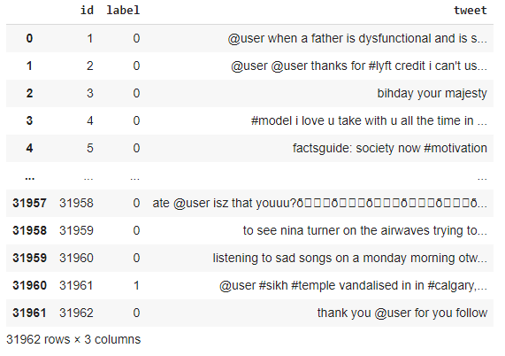
Exploratory Data Analysis (EDA)
Observations from Figure 2:
There is a lot of noise in the data
There are three total columns in the dataset
The number of observations is equal to 31962
Figure 2: Dataframe of the data

Slide 5
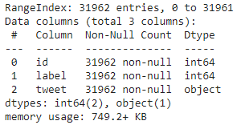

Figure 2: Dataframe of the data
Figure 3: Table showing the number of examples each class has
Observations from Figure 2:
There are no null values in the dataset
The data type of the tweet column is String object
The data type of both id and label columns is int64
The size of the data is 749.2+ KB
Observations from Figure 3:
The data given is unbalanced where the number of data samples labeled 0 is about 13 times higher than the samples labeled 1, which causes an overfitting problem for models, as they mostly predict zeros. A possible solution would be to collect more hate tweets data.

Slide 6
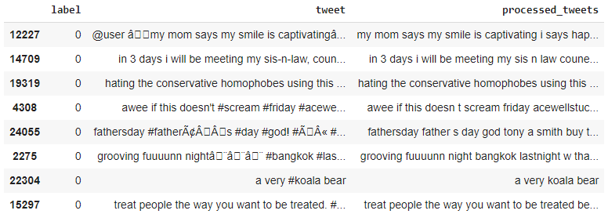
Figure 5: A sample of the result after shuffling and cleaning the data

Slide 7
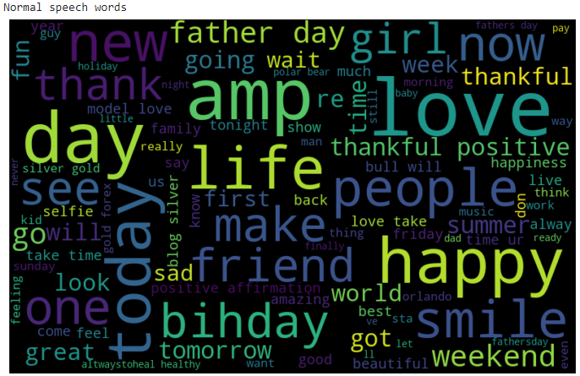
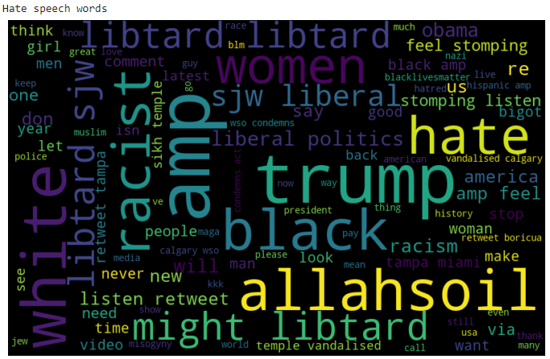
Normal Speech Words
Hate Speech Words
Figure 6: WordCloud to show the most frequent words in normal tweets ( the bigger the word the more frequent it is )
Figure 7: WordCloud to show the most frequent words in hate tweets ( the bigger the word the more frequent it is )

Slide 8
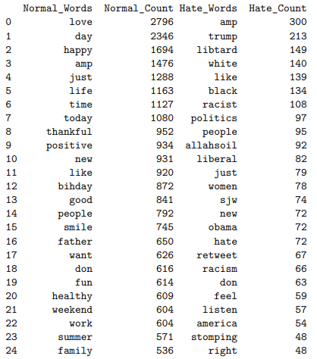
Top 25 Frequent Words
Figure 8: Dataframe to represent the top 25 used normal and hate words with their count

Slide 9
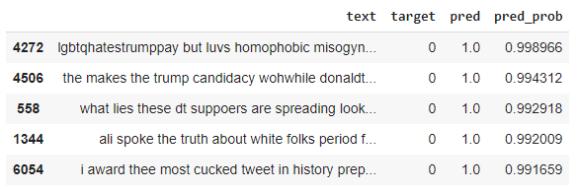
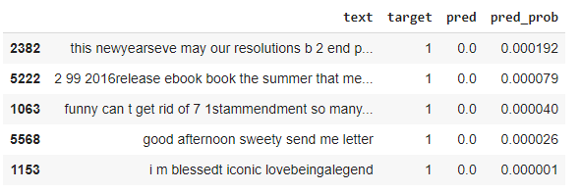
Finding the Most Wrong Predictions
Figure 9: Dataframe show casing the top False Positive examples
Figure 10: Dataframe show casing the top False Negative examples
Checking the most wrong predictions would help us know where the model is suffering the most, which helps us identify possibly mislabeled data and fix it.

Slide 10
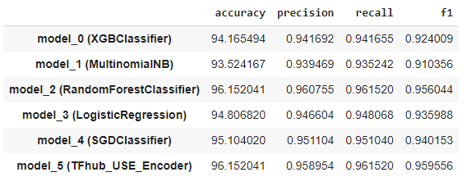
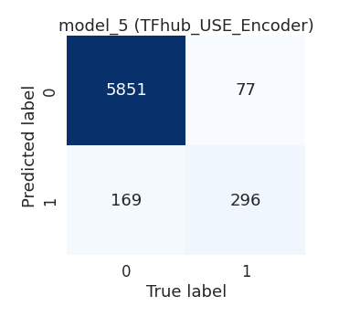
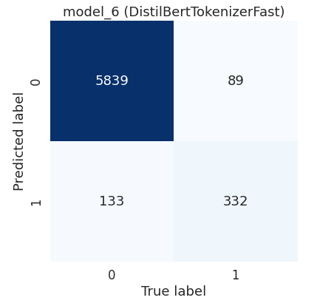
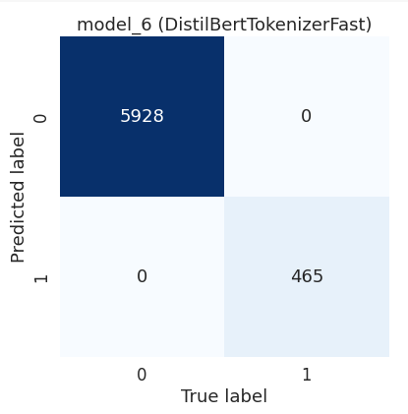

Models Performance Comparison
Figure 11: Dataframe showcasing early models results
Observations from Figure 12
Model_5 (TFhub_USE_Encoder) had the best f1-score, which is our main evaluation metric.
Figure 12: Dataframe showcasing model 6 results
Although model_5 was the best performing between early models, it was beaten later by model_6 (DistilBertTokenizerFast) which gave an f1-score of 0.964. So I would recommend using model_6.
Figure 13: Confusion matrix for each of model_5 & 6

Slide 11
Recommendations
Collect more tweets containing hate speech.
Check the most wrong predictions as shown in the EDA and fix the incorrectly labeled tweets.
Although model_5 was the best performing model in the early stage of experimenting, it was beaten later by model_6 (DistilBertTokenizerFast), which gave an f1-score of 0.964. So I would recommend using model_6.

Slide 12
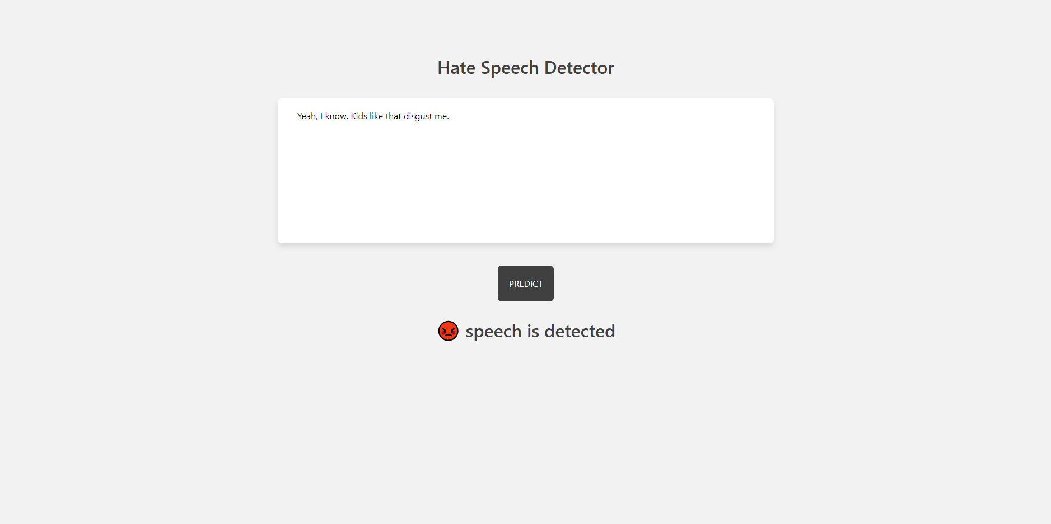
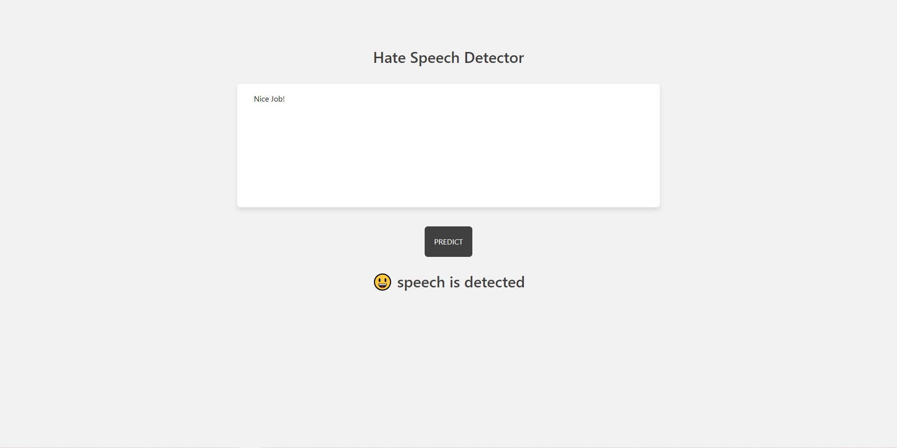
Deployment of Model 6
Figure 14: Showcasing model 6 detection of hate speech
Figure 15: Showcasing model 6 detection of positive or normal speech

Slide 13
Group Name: AO
Name: Alaa Eddine Osta
Email: ostaalaaeddine@gmail.com
Country: Lebanon
College: Üsküdar University
Specialization: NLP
Thank You

